Slide 1
FIN 654: FINANCIAL Analytics
SUPPLEMENT WeekS 8-9
Note: Code contained here is from a mix of sources as listed in References Slide(s)

Slide 2
Portfolio Theory
Two principles
maximize the expected return
minimize the risk
This requires optimal compromises.
Measures of risk
Standard deviation
Monetary loss (especially , large losses)
Risk premium = difference in expected return of a risky asset and the risk-free rate of return, or R_{i} = r_{i} – r_{f}
Covariance and Correlation
Cov(R₁,R₂) = ρ₁₂σ₁σ₂
Key concepts
Reduction of risk by diversifying portfolio
Positive correlation increases risk, whereas negative correlation decreases risk
Two assets
If two risky assets have returns R₁ and R₂ and we mix them in proportions w₁ and w₂ where w₁+w₂ = 1, then:
Return on the portfolio is
Rp = w₁R₁ +w₂R₂
Variance of the return is
σ_{P}² = w₁σ₁² + w₂σ₂² + 2 w₁w₂ ρ₁₂σ₁σ₂
Variance in the special case when R₂ is risk-free asset
σ_{P}² = w₁σ₁²

Slide 3
Portfolio Formulas
Three assets
Portfolio Return
Rp = w₁R₁ + w₂R₂ + w₃R₃
Portfolio Variance
σ_{P}² = w₁σ₁² + w₂σ₂² + w₃σ₃² + 2 w₁w₂ ρ₁₂σ₁σ₂ + 2 w₁w₃ ρ₁₃σ₁σ₃ + 2 w₂w₃ ρ₂₃σ₂σ₃
‘n’ assets
Portfolio Return
Rp = w₁R₁ +w₂R₂ + … +w_{n}R_{n}
Portfolio Variance
σ_{P}² = w₁σ₁² + w₂σ₂² + w₃σ₃² + … + w_{n}σ_{n}²
+ 2 w₁w₂ ρ₁₂σ₁σ₂ + 2 w₁w₃ ρ₁₃σ₁σ₃ + … + 2 w₁w_{n} ρ_{n}σ₁σ_{n}
+ 2 w₂w₃ ρ₂₃σ₂σ₃ + … + 2 w₂w_{n} ρ_{n}σ₂σ_{n}
+ … + …
+ 2 w_{n-1}w_{n} ρ_{n}σ_{n-1}σ_{n}

Slide 4
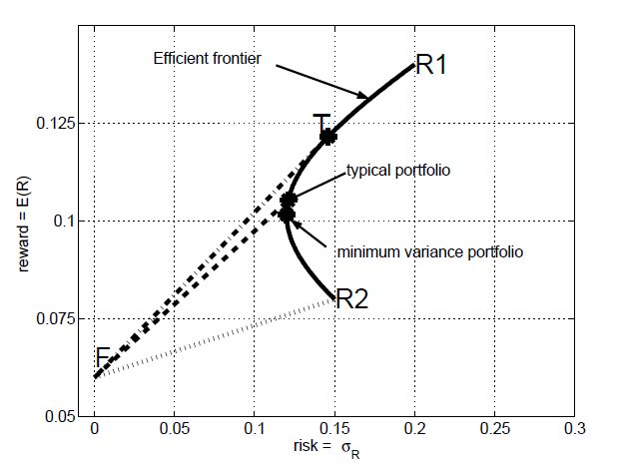
Portfolio Combinations
Combination line: Plot of E(r) and σ_{R} of various portfolios (combinations) of two risky returns on securities (assets).
The parabola (if plotted on the x-axis) is called the expected return-standard deviation frontier, and more commonly referred to as mean-variance frontier.
The upper half of the mean-variance frontier is known as the efficient frontier, since it consists of efficient portfolios – ones with highest expected return for the specified level of risk.
Two assets:
The portfolio combinations fall on the parabola.
Three or more assets:
The portfolio combinations fall within or on the parabola.
Portfolios that fall on the parabola offer either the highest or the lowest expected return for a given level of standard deviation.
We prefer the portfolios that offer the higher expected returns for a given level of risk (by standard deviation of returns)
R1 = risky asset 2
R2 = risky asset 2
F = risk-free asset
T = tangency portfolio

Slide 5



Portfolio Selection
Markowitz optimal portfolio selection process
Choose weights to minimize the portfolio risk given risk-adjusted return targets
Return matrix
Mean return vector
Measure of portfolio risk is a quadratic form that looks like
Function solve.QP() in package ‘quadprog’ in R
Solves quadratic programming problem:
min(−d^{T}x + ½ x^{T} Dx) with constraints A^{T}x >= b₀
Usage: result <- solve.QP (Dmat, dvec, Amat, bvec, meq)
Using solve.QP() for portfolio optimization
d^{T} is set to [0…. 0]
x^{T} is the weights matrix w^{T}
D is set to 2 * Cov matrix (D/2 = Cov)
meq is set to 2 (beyond that are the inequality constraints)
equality constraints are: [sum of weights], [expected return]
Outputs: result$value is the computed variance and result$solution contains the computed weights.

Slide 6
Optimal Portfolios
Sharpe’s Ratio
It is a measure of the performance of the overall portfolio
It is the amount of portfolio premium per unit of risk (the “price” of risk) across all combinations of portfolio assets on the efficient frontier
It is a “reward-to-risk" ratio, computed as (r_{P} - r_{i}) / σ_{P}
A maximized Sharpe ratio represents the best combination for the risk in terms of returns
This portfolio is called the tangency portfolio since its line is tangent to the efficient frontier
Combining risky assets with a risk-free asset
When a risk-free asset is available, then the efficient portfolios are no longer those on the efficient frontier.
The optimal or efficient portfolios mix the tangency portfolio with the risk-free asset.
Each efficient portfolio has two properties:
higher expected return than any other portfolio with the same or smaller risk
smaller risk than any other portfolio with the same or higher expected return
Note that all efficient portfolios use the same mix of the risky assets, namely, the tangency portfolio.

Slide 7
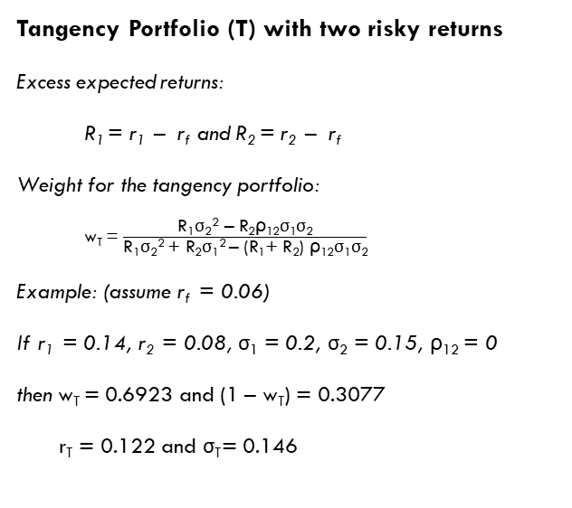
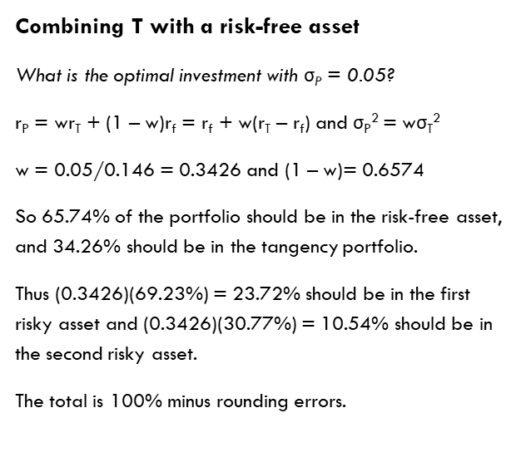
Simple Example
Tangency Portfolio (T) with two risky returns
Excess expected returns:
R₁ = r₁ – r_{f} and R₂ = r₂ – r_{f}
Weight for the tangency portfolio:
w_{T} = $\frac{\text{R}\text{1}\text{σ}\text{2}\text{2} \text{–} \text{R}\text{2}\text{ρ}\text{12}\text{σ}\text{1}\text{σ}\text{2}}{\text{R}\text{1}\text{σ}\text{2}\text{2} \text{+ }\text{R}\text{2}\text{σ}\text{1}\text{2} \text{–}\text{ (}\text{R}\text{1}\text{+ }\text{R}\text{2}\text{) }\text{ρ}\text{12}\text{σ}\text{1}\text{σ}\text{2}}$
Example: (assume r_{f} = 0.06)
If r₁ = 0.14, r₂ = 0.08, $\text{σ}\text{1}$ = 0.2, $\text{σ}\text{2}$ = 0.15, $\text{ρ}\text{12}$ = 0
then w_{T} = 0.6923 and (1 – w_{T}) = 0.3077
r_{T} = 0.122 and $\text{σ}\text{T}$= 0.146
Combining T with a risk-free asset
What is the optimal investment with $\text{σ}$_{P} = 0.05?
r_{P} = wr_{T} + (1 – w)r_{f} = r_{f} + w(r_{T} – r_{f}) and σ_{P}² = wσ_{T}²
w = 0.05/0.146 = 0.3426 and (1 – w)= 0.6574
So 65.74% of the portfolio should be in the risk-free asset, and 34.26% should be in the tangency portfolio.
Thus (0.3426)(69.23%) = 23.72% should be in the first risky asset and (0.3426)(30.77%) = 10.54% should be in the second risky asset.
The total is 100% minus rounding errors.
Notes:
Portfolio Chapter – David Ruppert and David S. Matteson. 2014. Statistics and Data Analysis for Financial Engineering, Springer.

Slide 8

Selling Short
“
The weights in an efficient portfolio could be negative. A negative weight on an asset means that the asset is sold short. Selling short is a way to profit if the price goes down.
To sell a stock short, one sells the stock without owning it. The stock must be borrowed from a broker or customer of the broker. At a later point in time, one buys the stock and gives it back to the lender. This closes the short position.
If one sells a stock short, one is said to have a short position in that stock, and owning the stock is called a long position.
“
Varying constraints in solve.QP()
The linear inequality constraints are
A^{T}_{neq}x >= b_{neq}
The linear equality constraints are
A^{T}_{eq}x = b_{eq}
Function solve.QP combines A^{T}_{eq} and A^{T}_{neq} into a single matrix Amat by stacking A^{T}_{eq} on top of A^{T}_{neq}
The parameter meq is the number of rows of A^{T}_{eq}
Notes:
Portfolio Chapter – David Ruppert and David S. Matteson. 2014. Statistics and Data Analysis for Financial Engineering, Springer.

Slide 9
Reference books
David Ruppert and David S. Matteson. 2014. Statistics and Data Analysis for Financial Engineering, Second Edition, Springer.
Alexander McNeil, Rudiger Frey, and Paul Embrechts, 2015. Quantitative Risk Management: Concepts, Techniques, and Tools Princeton, 2014.
Bennet and Hugen. 2016. Financial Analytics with R: Cambridge Univ Press.
Paul Teetor. 2011. R Cookbook. O’Reilly: Sebastopol, CA.
Phil Spector. Data Manipulation with R.
Norman Matloff. The Art of R Programming: A Tour of Statistical Software Design.
John Taveras. R for Excel Users at https://www.rforexcelusers.com/book/.
Winston Chang. 2014. R Graphics Cookbook. O’Reilly: Sebastopol, CA.

Slide 10
Reference links
http://www.cookbook-r.com/
https://books.google.com/books?id=fxL4tu5bzAAC&printsec=frontcover
https://www.datacamp.com/courses/free-introduction-to-r
http://www.r-tutor.com/r-introduction/
https://www.statmethods.net/
https://livebook.manning.com/#!/book/r-in-action-second-edition/
https://blog.rstudio.com/2015/06/24/leaflet-interactive-web-maps-with-r/
https://www.analyticsvidhya.com/blog/2015/07/guide-data-visualization-r/
https://jabranham.com/blog/2015/09/rmarkdown-vs-latex/
https://www.revolvy.com/main/index.php?s=YAML

